Slide 1
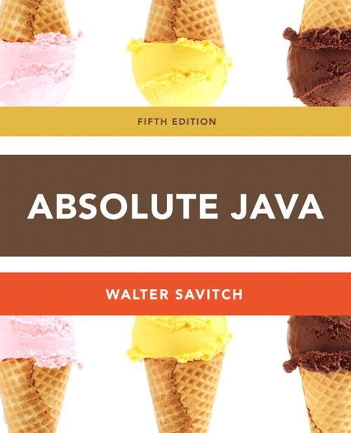
Chapter 4
Information Hiding and Encapsulation Section 4.2
Slides prepared by Rose Williams, Binghamton University
Kenrick Mock, University of Alaska Anchorage

Slide 2
Information Hiding and Encapsulation
Information hiding is the practice of separating how to use a class from the details of its implementation
Abstraction is another term used to express the concept of discarding details in order to avoid information overload
Encapsulation means that the data and methods of a class are combined into a single unit (i.e., a class object), which hides the implementation details
Knowing the details is unnecessary because interaction with the object occurs via a well-defined and simple interface
In Java, hiding details is done by marking them private

Slide 3
A Couple of Important Acronyms: API and ADT
The API or application programming interface for a class is a description of how to use the class
A programmer need only read the API in order to use a well designed class
An ADT or abstract data type is a data type that is written using good information-hiding techniques

Slide 4
public and private Modifiers
The modifier public means that there are no restrictions on where an instance variable or method can be used
The modifier private means that an instance variable or method cannot be accessed by name outside of the class
It is considered good programming practice to make all instance variables private
Most methods are public, and thus provide controlled access to the object
Usually, methods are private only if used as helping methods for other methods in the class

Slide 5
Accessor and Mutator Methods
Accessor methods allow the programmer to obtain the value of an object's instance variables
The data can be accessed but not changed
The name of an accessor method typically starts with the word get
Mutator methods allow the programmer to change the value of an object's instance variables in a controlled manner
Incoming data is typically tested and/or filtered
The name of a mutator method typically starts with the word set

Slide 6
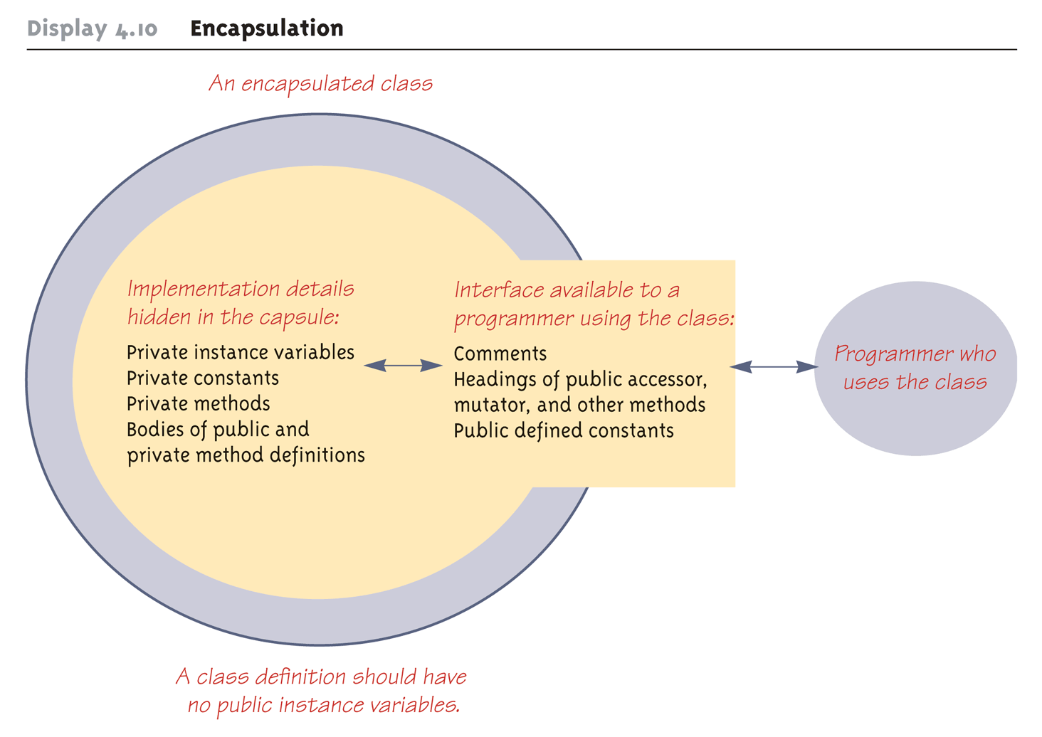
Encapsulation

Slide 7
A Class Has Access to Private Members of All Objects of the Class
Within the definition of a class, private members of any object of the class can be accessed, not just private members of the calling object

Slide 8
Mutator Methods Can Return a Boolean Value
Some mutator methods issue an error message and end the program whenever they are given values that aren't sensible
An alternative approach is to have the mutator test the values, but to never have it end the program
Instead, have it return a boolean value, and have the calling program handle the cases where the changes do not make sense

Slide 9
Preconditions and Postconditions
The precondition of a method states what is assumed to be true when the method is called
The postcondition of a method states what will be true after the method is executed, as long as the precondition holds
It is a good practice to always think in terms of preconditions and postconditions when designing a method, and when writing the method comment

